Slide 1
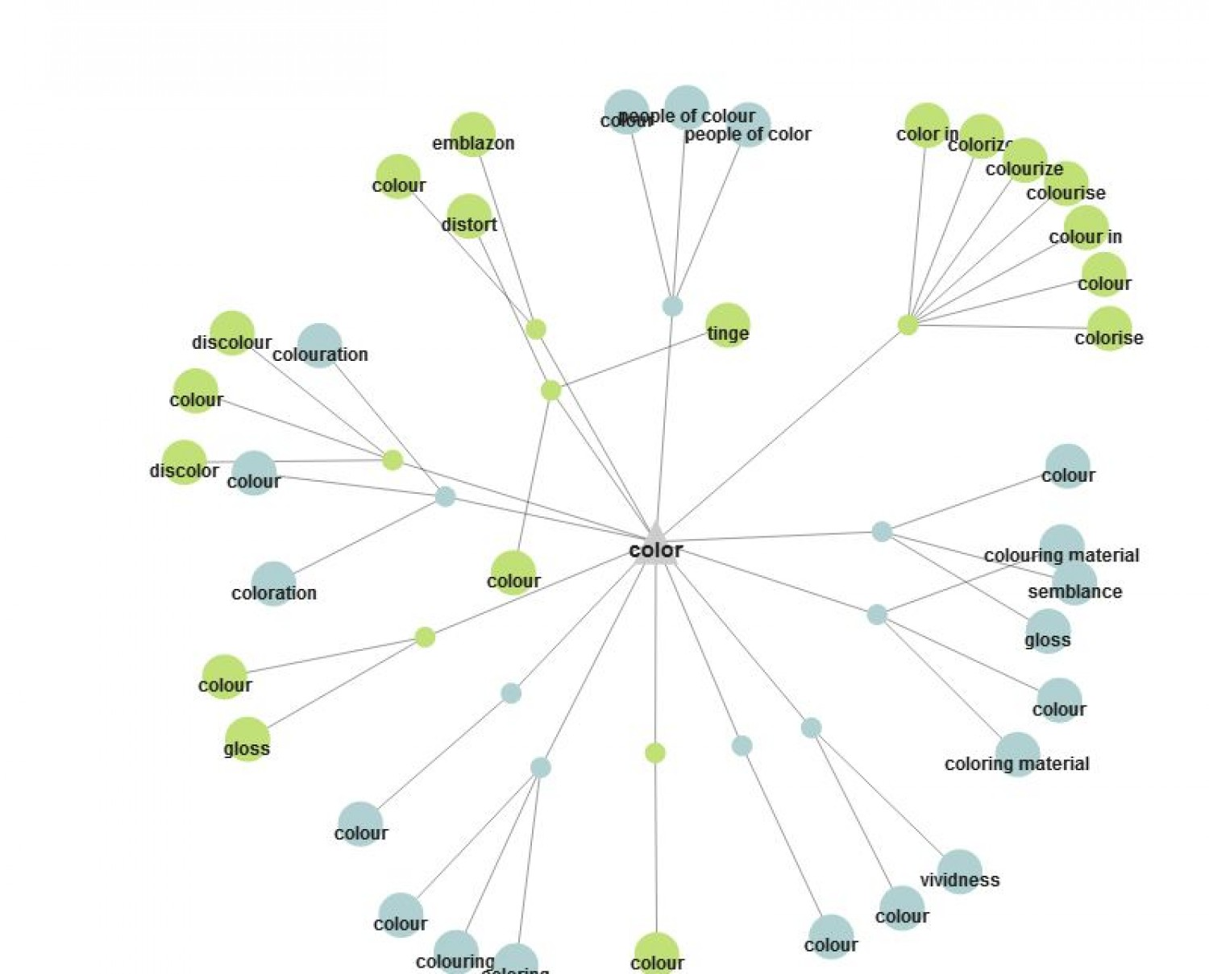
Editable Ontology Graphical UI
Senior Project Design
CSE-499
Mohammad Raihan Sarker Razu
Id- 1520079042
Supervised By:
Mohammad Ashrafuzzaman Khan
Arona Dorin Chowdhury
Id- 1520045642
Tamim Ahmend
Id- 1520698642

Slide 2
1
Introduction
Now is the age of information technology. In every place, every sector of technology is dominated by its power.
Using technology means using lots of information.
Information = Data
We can represent data either tabular format or graphical format. Tabular format mostly like static visualization, on the other hand, the graphical format is dynamic representation. It attracts a man more then tabular data visualization.
For handling BIG data graphical representation gives more reliability.

Slide 3

2
Project basic idea
Server
User
R
E
S
T
A
P
I
Knowledge
Base
Edit graph
out
out
in
in
Neo4j
--------
Ontology
JavaScript
Job Resume
Our target is the circular part

Slide 4
3
Problem
If a user wants to edit (add/delete) the data graph then he/she needs to do some change in database. Mainly he/she writes some query for the edit of data. This is not a easy task for all.

Slide 5
4
Solution
Neo4j gives us a graph of given data where we can only view the graph. If we need to add new data or delete the data then we have to implement the process through DBMS. This means we need to write some query language.
However, our ultimate goal is adding, deleting data from the User interface graph; where users can edit information such as adding, deleting, do not need to write any query.
Moreover, we don’t need any DBMS access through this process such as Neo4j.

Slide 6
5
Goal
Our goal is to make a user interface where the user can edit the graph(ontology) very easily. Such as add, delete, save.

Slide 7
6
Tools to be used
Knowledge
Base
Neo4j
--------
Ontology
We mainly work on the WEB platform.
Java Script for frontend,
REST API for the transaction of data among database and user interface,
Neo4j for a database management system,
*
PHP if needed

Slide 8
7
Background work
Protege

Slide 9
8
Protege
Protege is a free, open source ontology editor and a knowledge management system. Protege provides a graphic user interface to define ontologies. It also includes deductive classifiers to validate that models are consistent and to infer new information based on the analysis of an ontology. Like Eclipse, Protege is a framework for which various other projects suggest plugins. This application is written in Java and heavily uses Swing to create the user interface. Protege recently has over 300,000 registered user’s. According to a 2009 book it is "the leading ontological engineering tool.
Protégé is being developed at Stanford University and is made available under the BSD 2-clause license. Earlier versions of the tool were developed in collaboration with the University of Manchester.

Slide 10
9
How to use Protege ?
First, make sure that "DIG Reasoner" is selected in the Reasoning menu (the default selection when you install Protege). The Reasoning menu allows you to select which is the current reasoned that should be used when the users classifies the ontology, checks the consistency, computes the inferred types, etc.

Slide 11
10
How it WORKS ?
Protege is a good exploratory and experimentation environment. Quick iterations are possible between model, data, and application changes. Database tables are designed and optimized to work with a particular application in mind. Instead access the data though the Protégé API.

Slide 12

Thanks to all,
for listening..

